Slide 1
Liver Patient Analysis
Predicting if a Patient Has liver disease or not

Slide 2
Ismam Hussain Khan(1610991642)

Slide 3
Data Set:
> Collected From Kaggle
>Contains 584 instances
>Contains 10 attribute column and 1 result column

Slide 4
Attributes
1.Age
2.Gender
3.total BIlrubin
4.Direct Bilirubin
5.Alkaline Phosphotase
6.Alamine Aminotransferase
7.Aspartate Aminotransferase

Slide 5
8.Total_Protiens
9.Albumin
10.Albumin_and_Globulin_Ratio
11.Dataset

Slide 6
Preprocess
1)I found that there were 4 values missing in the column Albumin_and_Globulin_Ratio so i counted the mean of that column and filled them with that mean.
2)I also dropped the gender column to fit that into my logistic regression model

Slide 7
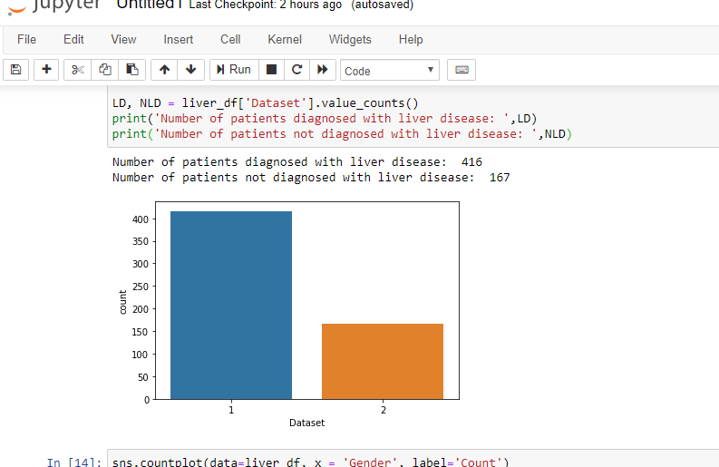
Data Visualization

Slide 8
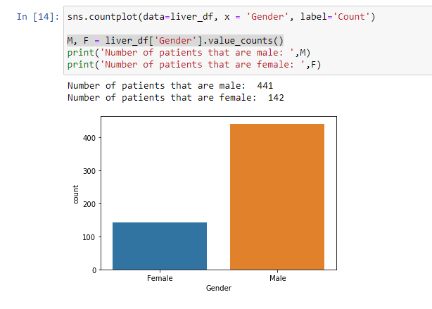

Slide 9
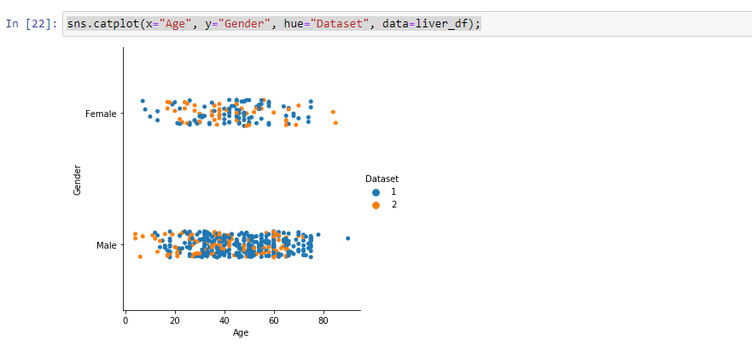

Slide 10
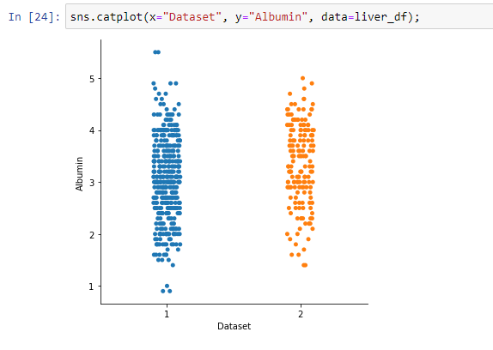

Slide 11
Splitting the data and Training
1.I split the data into training and test set randomly with 70% data on the training set and 30% on the test set
2.After that i trained the data using logistic regression

Slide 12
Result
Training score was 73.53%
Testing score was 72.57%

Slide 13
Future Works
In future i will test the data with other algorithms and try to find more relations between the attributes and will also try to improve accuracy.

Slide 14
Thank You!

